Slide 1
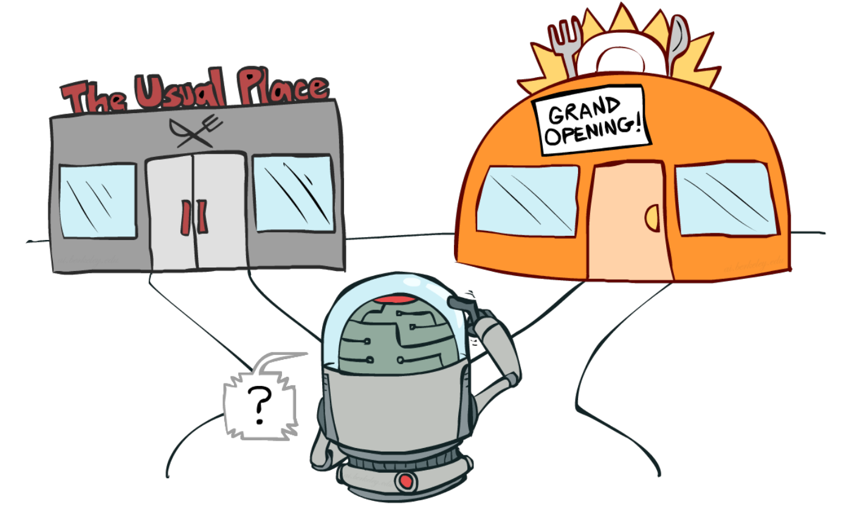
Multi-Armed Bandits
Hongning Wang
CS@UVA

Slide 2
Outline
Problem formulation
Classical exploration strategies
Advanced bandit problems
Beyond our textbook!

Slide 3

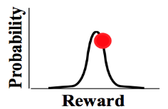
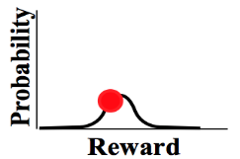
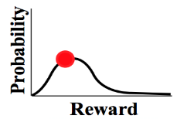


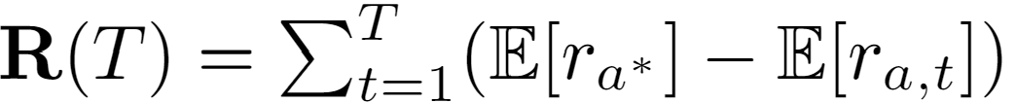





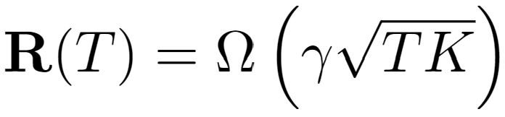

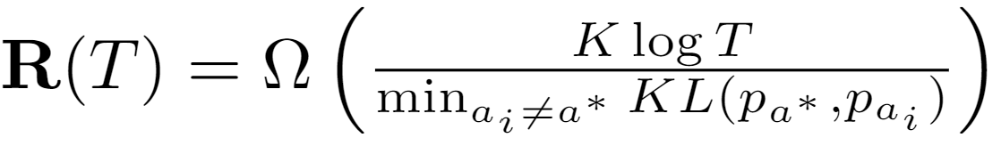
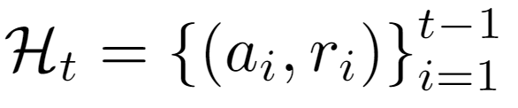
Problem formulation
Adversarial bandit is out of scope of this lecture
(stochastic) Multi-arm bandit
…
Goal: maximize the accumulated reward over T rounds
Reward distribution
(Pseudo) Regret: expected loss due to not playing the best arm
…
Actions
Regret
Agent/learner/policy
Reward
Lower regret bound [LR85]:
Lower regret bound [Aue95]:
Time
History
Finite variance is required!
Sub-linear regret is preferred!
Difficulty of the problem

Slide 4











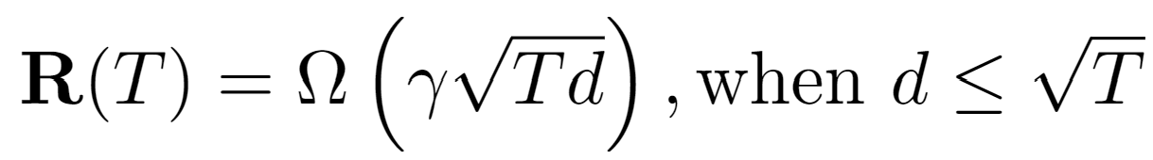
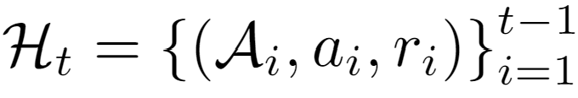
Problem formulation
In linear contextual bandit [LCLS10],
Contextual/structured bandit
…
Goal: maximize the accumulated reward over T rounds
Reward distribution
(Pseudo) Regret: expected loss due to not playing the best arm
…
Actions
Agent/learner/policy
Reward
Lower regret bound in linear contextual bandit [CLRS11]:
History

Slide 5

Discussion
Why is multi-armed bandit problem difficult?

Slide 6





Problem formulation
Reinforcement learning [SB18]
A simplified RL problem!
State
Reward
Action

Slide 7
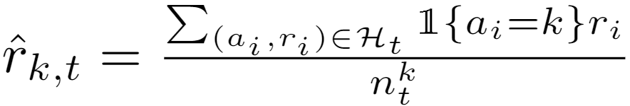
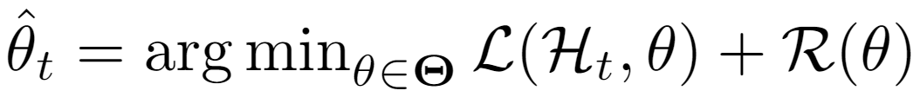
Problem formulation
In linear contextual bandit [LCLS10],
Ridge regression, closed form solution exists!
Key problems
  Reward estimation
  Arm selection
Reward
Action
Convergence matters!
Exploration matters!
Multi-arm bandit:
Contextual bandit:
Adaptive v.s., non-adaptive
Independent v.s., collaborative
Unconstrained v.s., constrained
Loss function Regularization

Slide 8

Discussion
Why is exploration necessary?
How to perform exploration?
How to balance it with exploitation?

Slide 9
Classical exploration strategies
Random exploration
Optimism in the face of uncertainty
Posterior sampling
Perturbation-based

Slide 10

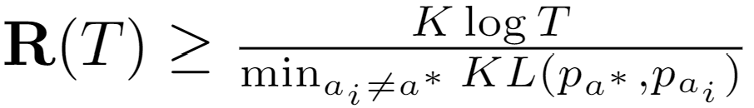

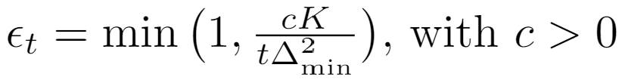






Random exploration
Lower regret bound of MAB:
Reward estimation in MAB:
Constant leads to linear regret!
$ε$-greedy [Aue02]
By setting , we have
Arm selection
Non-adaptive; often leads to sub-optimal performance in practice.

Slide 11

Warning
Turbulence ahead!

Slide 12

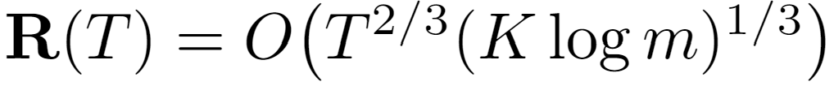


Random exploration
Epoch greedy [LZ08]
  Explore and then commit
Explore by one step
Size of hypothesis space, which makes the exploration adaptive
Length of epoch
Exploit by one epoch

Slide 13
Recap: random exploration
Constant leads to linear regret!
$ε$-greedy [Aue02]
By setting , we have
Arm selection
Non-adaptive; often leads to sub-optimal performance in practice.

Slide 14
Recap: random exploration
Epoch greedy [LZ08]
  Explore and then commit
Explore by one step
Size of hypothesis space, which makes the exploration adaptive
Length of epoch
Exploit by one epoch

Slide 15
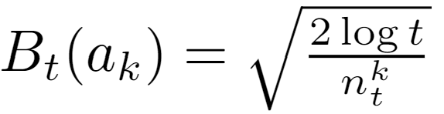



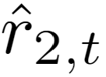
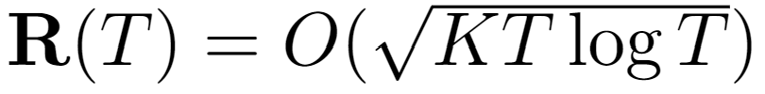
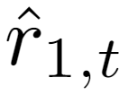
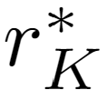


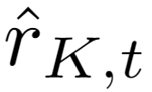
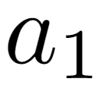



Optimism in the face of uncertainty
Lower regret bound of MAB:
UCB1 [Aue02]
  Upper confidence bound based
Reward
Encourage underestimated arms
…

Slide 16
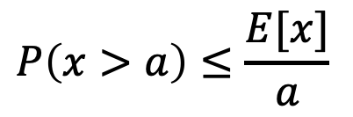

Why is it always square root?
Concentration inequality
  E.g., law of large numbers $\lim_{n→∞}\frac{1}{n}\sum_{i=1}^{n}{x_{i}}=E[x]$
  A way to quantify how a set of iid random variables deviate from a chosen value of interest
  Markov’s inequality for non-negative random variables
$$P\left(x>a\right)≤\frac{E[x]}{a}$$

Slide 17
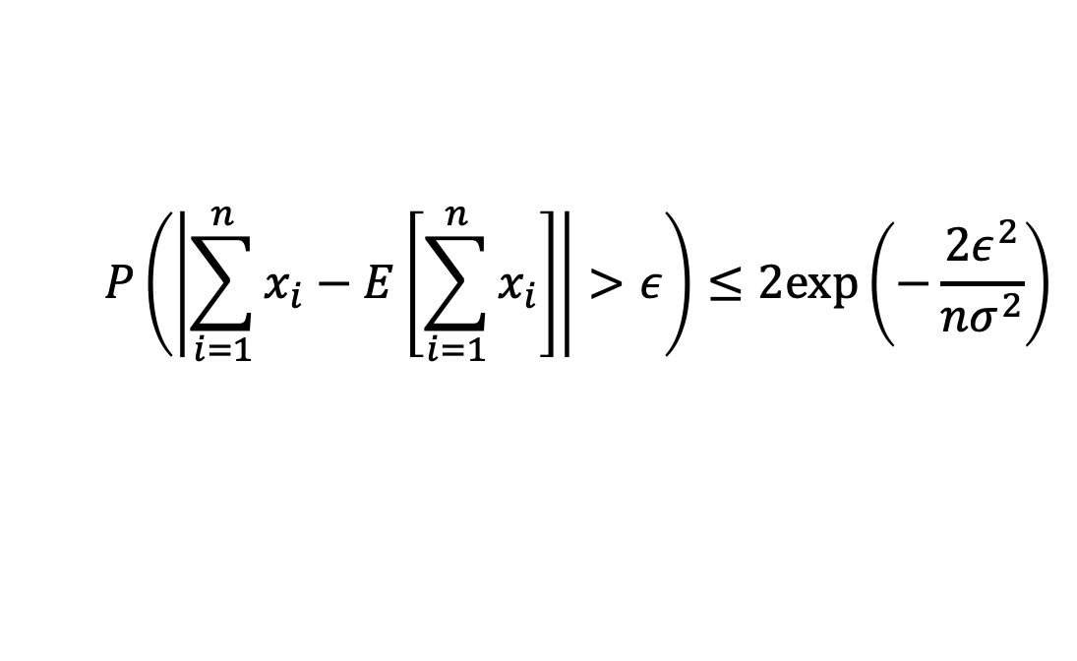
Why is it always square root?
Concentration inequality
  Hoeffding's inequality
$$P\left(\left|\sum_{i=1}^{n}{x_{i}}−E\left[\sum_{i=1}^{n}{x_{i}}\right]\right|>ε\right)≤2exp\left(−\frac{2ε^{2}}{nσ^{2}}\right)$$
${\left\{x_{i}\right\}}_{i=1}^{n}$ are iid random variables with finite variance $σ^{2}$

Slide 18
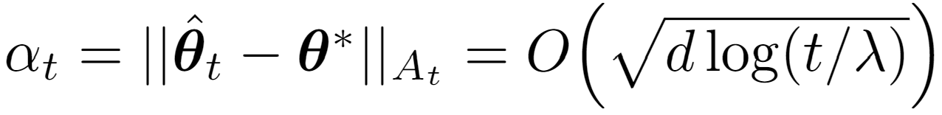
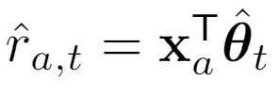
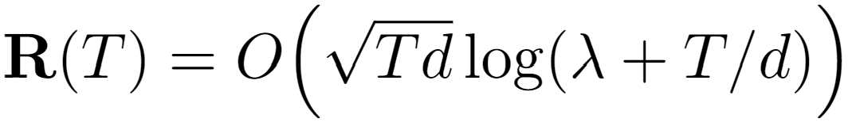
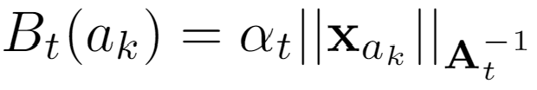
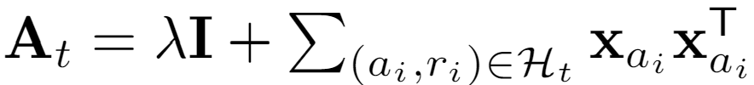


Optimism in the face of uncertainty
Lower regret bound in linear contextual bandit [CLRS11]:
In linear contextual bandit,
LinUCB [LCLS10]
  Upper confidence bound based
Confidence ellipsoid
Reward
Encourage underestimated arms
…
Closed form estimator

Slide 19
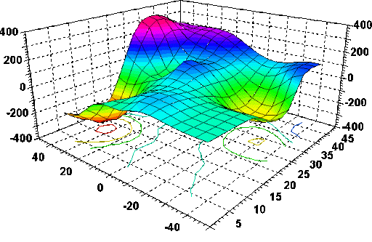



Visualization of contextual bandits
$$x_{3}$$
$$x_{1}$$
$$x_{2}$$

Slide 20



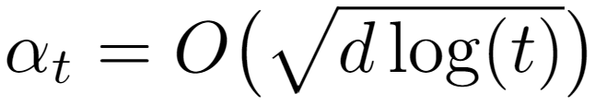
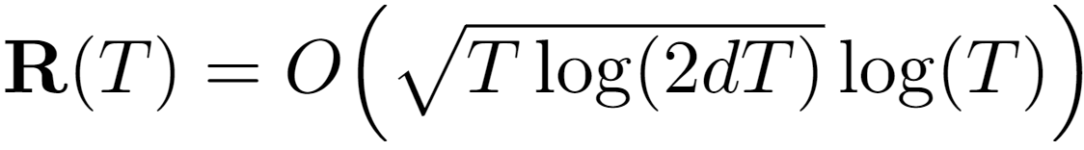

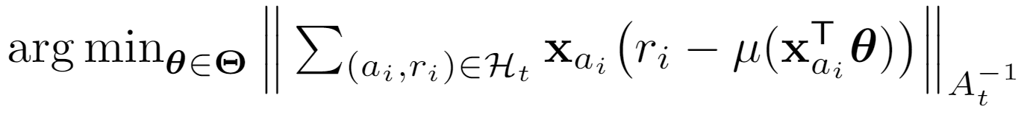
Optimism in the face of uncertainty
In generalized linear bandit,
In linear contextual bandit [LCLS10],
GLM-UCB [FCGS10]
  A generalized linear model
Link function, e.g.,
Confidence ellipsoid
Reward
Encourage underestimated arms
No closed form solution for
…
Using gradient descent to solve
where

Slide 21
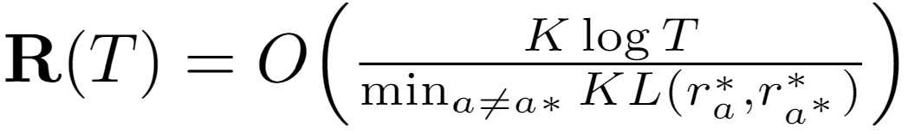
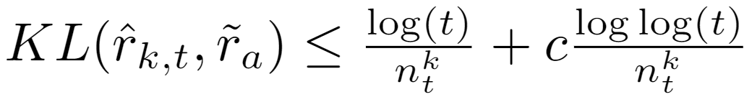
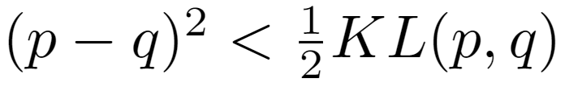

Optimism in the face of uncertainty
Lower regret bound of MAB:
KL-UCB [GC11]
  Compute upper confidence bound directly
Range of reward
A hyper-parameter
Reward
Encourage underestimated arms
Asymptotically optimal!
…
Intuition:
Pinsker's inequality

Slide 22
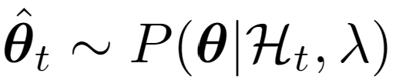
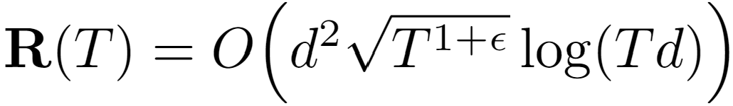

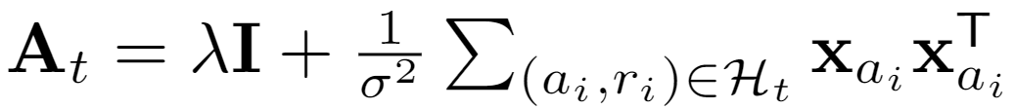

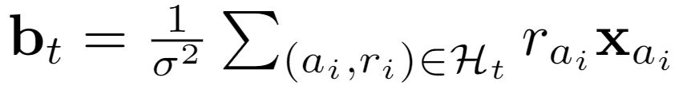
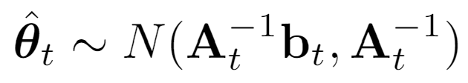
Posterior sampling
In linear contextual bandit [LCLS10],
Predictive distribution:
Thompson sampling [AG13]
Source of uncertainty
A Bayesian perspective of reward estimation:
prior
related to prior
Reward
…
Analytic form of posterior
Prior:

Slide 23
Posterior sampling
No formal regret known yet; and some analysis from Bayesian regret perspective
Thompson sampling [RVKOW18]
  No analytic posterior?
  Approximate posterior inference!
    Gibbs sampling
    Particle sampling
    Laplace approximation
    Bootstrapping

Slide 24
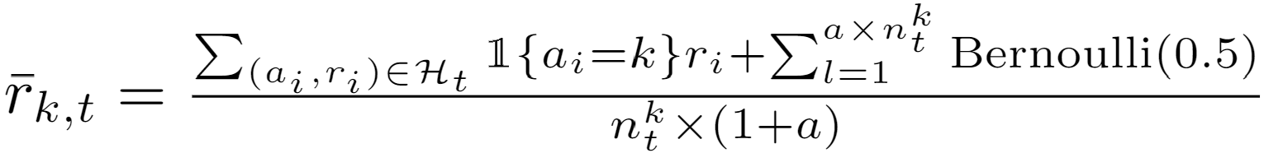
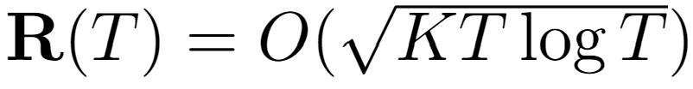

Perturbation-based
1) Concentrates at a scaled and shifted mean reward;
2) It is an overestimation with a high probability.
Perturbed history exploration [KSGB19a]
Encourage underestimated arms
Reward
Encourage underestimated arms
…
…

Slide 25

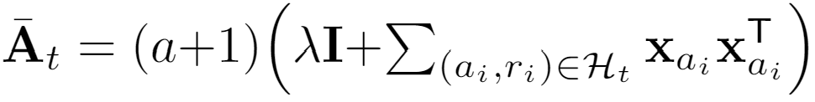


Perturbation-based
1) Concentrates at a scaled and shifted mean reward;
2) It is an overestimation with a high probability.
Perturbed history exploration [KSGB19b]
    With a linear model?
Closed form estimator
00
Reward
…
…
Added reward variance

Slide 26


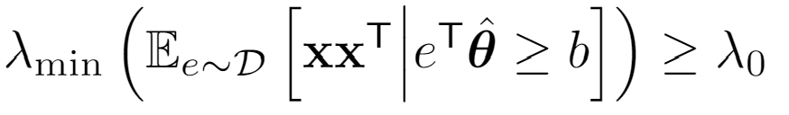
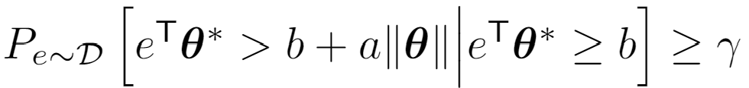
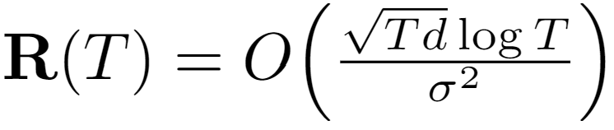

Perturbation-based
Adversary’s choice, could be adaptive
1) Perturbed adversary
Perturbed adversary [KMRWW18]
  How would a greedy solution perform?
2) Diversity
3) Conditional margin
Reward
Encourage underestimated arms
…
Closed form estimator

Slide 27
Advanced bandit problems
Collaborative bandits
Non-stationary bandits
Fair bandit learning

Slide 28
A design question
How do we formulate the problem of recommendation as a bandit problem?
  Setting: recommending K items to N users
  What are arms?
  What’s the reward?

Slide 29




Collaborative bandit learning
$N$ users, each user has his/her own $θ$
  Build independent LinUCB for each user?
  Cold start challenge in personalized systems
  Users are not independent
Leverage user dependency for efficient exploration
  Use existing user dependency information
  Discover dependency online (via clustering)

Slide 30
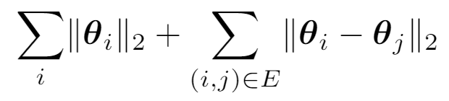
Collaborative bandit learning
GOBLin [CGZ13]
  Connected users are assumed to share similar model parameters
  Graph Laplacian based regularization upon ridge regression to model dependency
Graph $E$ is input. Regularization term:

Slide 31




Collaborative bandit learning
GOBLin [CGZ13]
  Graph Laplacian based regularization upon ridge regression to model dependency
  Encode graph Laplacian in context, formulate as a dN-dimensional LinUCB
Closed form estimator
Graph Laplacian

Slide 32












Collaborative bandit learning
CoLin [WWGW16]
  Social influence among users: content and opinion sharing in social network $W$
  Reward: weighted average of expected reward among friends
  A dN-dimensional LinUCB
in which
Closed form estimator
When $W$ is uniform, i.e, all users are uniformly connected to share:
Regret:
0.6 | 0.1 | 0.2 | 0.0
0.0 | 0.7 | 0.0 | 0.0
0.0 | 0.1 | 0.8 | 0.5
0.4 | 0.1 | 0.0 | 0.5

Slide 33



Online clustering
Remove edge if
CLUB[GLZ14]
  Adaptively cluster users into groups Threshold to remove edges is based on closeness of the users’ models
  Build LinUCB on each cluster
Regret: . Reduce regret from N (users) to m (clusters)
Closed form estimator

Slide 34



Non-stationary bandits
Problem formulation
Non-stationary
…
…
Reward distribution
…
Real-time click-through-rate of 4 news articles collected from Yahoo user click log dataset
Actions
What’s the deal?
I need to be adaptive about potential changes in the environment
☹
Agent/learner/policy
Reward
☺
Regret
History is no longer helpful and may even be misleading in the player’s decision-making
Time

Slide 35
The lecture will start at 9:30am EDT
Sli.do event code: 5585459

Slide 36
Recap: classical exploration strategies
Random exploration
Optimism in the face of uncertainty
Posterior sampling
Perturbation-based

Slide 37
Recap: collaborative bandit learning
$N$ users, each user has his/her own $θ$
  Build independent LinUCB for each user?
  Cold start challenge in personalized systems
  Users are not independent
Leverage user dependency for efficient exploration
  Use existing user dependency information
  Discover dependency online (via clustering)

Slide 38















Non-stationarity
  Different types of non-stationary environments
    Piecewise stationary environments
    Gradually changing environments
What should we do?
Key: how to detect the change?
More difficult and less studied.
Expected Reward
Expected Reward
Time
Time

Slide 39


CB based online change detection
Utilize the reward estimation confidence [WNW18, WWLW19]
  If the environment is stationary, the reward prediction residual should be within a confidence interval with high probability
Predicted reward of bandit model m
Observed reward
Confidence bound of reward estimation
We can bound this to further exclude this possibility!
Unexpected outcome is caused by,
Something wrong in the observed reward: large noise
Something wrong in the predicted reward: the model is incorrect

Slide 40








CB based online change detection
Prediction badness at interaction $i$:
Similar to the goodness of fit concept in chi-squared test
Badness of model m over a sliding time window:
a sliding time window to collect observations about badness
Detection threshold:
Bad enough:
Good enough:
Change detected.
(abandon model m)
When no learner is good enough, will also report a change.
(but do not abandon learner m)

Slide 41










CB based online change detection
dLinUCB [WNW18]
Adaptively creates new learners
Monitors the prediction quality of each learner
Selects a learner according to each learner’s ‘badness’
.
.
…
badness
badness
Badness estimation update
Reward estimation update
…
…

Slide 42


Fairness concerns
Machine bias – an important topic in machine learning
  Research of bias in data, model, algorithm etc.
    E.g., discriminatory treatment of subpopulations
  The need to explore
Fairness guarantee during online decision making (bandits)
How to define fairness in bandit learning?

Slide 43

FairUCB [JKMR16]
Idea: uniformly pull arm within the first confidence interval chain
  Start from the largest UCB, find overlapped confidence intervals
Guaranteed fairness at every step with high probability
Regret:
Fairness requirement: if arm a is truly better than b, the frequency we pull a should not be lower than b.
Reward
…

Slide 44
Takeaways
Efficiency matters in exploration
Various perspectives to perform exploration
  Confidence interval
  Posterior distribution
  Perturbation based
New challenges in bandit learning

Slide 45
References I
[SSSCJ16] Schnabel, T., Swaminathan, A., Singh, A., Chandak, N., & Joachims, T. (2016, June). Recommendations as treatments: debiasing learning and evaluation. In Proceedings of the 33rd International Conference on International Conference on Machine Learning-Volume 48 (pp. 1670-1679).
[LR85] Lai, T. L., & Robbins, H. (1985). Asymptotically efficient adaptive allocation rules. Advances in applied mathematics, 6(1), 4-22.
[Aue95] Auer, P., Cesa-Bianchi, N., Freund, Y., & Schapire, R. E. (1995, October). Gambling in a rigged casino: The adversarial multi-armed bandit problem. In Proceedings of IEEE 36th Annual Foundations of Computer Science (pp. 322-331). IEEE.
[LCLS10] Li, L., Chu, W., Langford, J., & Schapire, R. E. (2010, April). A contextual-bandit approach to personalized news article recommendation. In Proceedings of the 19th international conference on World wide web (pp. 661-670).
[CLRS11] Chu, W., Li, L., Reyzin, L., & Schapire, R. (2011, June). Contextual bandits with linear payoff functions. In Proceedings of the Fourteenth International Conference on Artificial Intelligence and Statistics (pp. 208-214).
[SB18] Sutton, R. S., & Barto, A. G. (2018). Reinforcement learning: An introduction. MIT press.
[Aue02] Auer, P. (2002). Using confidence bounds for exploitation-exploration trade-offs. Journal of Machine Learning Research, 3(Nov), 397-422.
[LZ08] Langford, J., & Zhang, T. (2008). The epoch-greedy algorithm for multi-armed bandits with side information. In Advances in neural information processing systems (pp. 817-824).
[FCGS10] Filippi, S., Cappe, O., Garivier, A., & Szepesvári, C. (2010). Parametric bandits: The generalized linear case. In Advances in Neural Information Processing Systems (pp. 586-594).
[GC11] Garivier, A., & Cappé, O. (2011, December). The KL-UCB algorithm for bounded stochastic bandits and beyond. In Proceedings of the 24th annual conference on learning theory (pp. 359-376).

Slide 46
References II
[AG13] Agrawal, S., & Goyal, N. (2013, February). Thompson sampling for contextual bandits with linear payoffs. In International Conference on Machine Learning (pp. 127-135).
[RVKOW18] Russo, D. J., Van Roy, B., Kazerouni, A., Osband, I., & Wen, Z. (2018). A Tutorial on Thompson Sampling. Foundations and Trends® in Machine Learning, 11(1), 1-96.
[KSGB19a] Kveton, B., Szepesvári, C., Ghavamzadeh, M., & Boutilier, C. (2019, August). Perturbed-history exploration in stochastic multi-armed bandits. In Proceedings of the 28th International Joint Conference on Artificial Intelligence (pp. 2786-2793). AAAI Press.
[KSGB19b] Kveton, B., Szepesvari, C., Ghavamzadeh, M., & Boutilier, C. (2019). Perturbed-history exploration in stochastic linear bandits. arXiv preprint arXiv:1903.09132.
[KMRWW18] Kannan, S., Morgenstern, J. H., Roth, A., Waggoner, B., & Wu, Z. S. (2018). A smoothed analysis of the greedy algorithm for the linear contextual bandit problem. In Advances in Neural Information Processing Systems (pp. 2227-2236).
[CGZ13] Cesa-Bianchi, N., Gentile, C., & Zappella, G. (2013). A gang of bandits. In Advances in Neural Information Processing Systems (pp. 737-745).
[WWGW16] Wu, Q., Wang, H., Gu, Q., & Wang, H. (2016, July). Contextual bandits in a collaborative environment. In Proceedings of the 39th International ACM SIGIR conference on Research and Development in Information Retrieval (pp. 529-538).
[GLZ14] Gentile, C., Li, S., & Zappella, G. (2014, January). Online clustering of bandits. In International Conference on Machine Learning (pp. 757-765).

Slide 47
References III
[WNW18] Wu, Q., Iyer, N., & Wang, H. (2018, June). Learning contextual bandits in a non-stationary environment. In The 41st International ACM SIGIR Conference on Research & Development in Information Retrieval (pp. 495-504).
[WWLW19] Wu, Q., Wang, H., Li, Y., & Wang, H. (2019, May). Dynamic Ensemble of Contextual Bandits to Satisfy Users' Changing Interests. In The World Wide Web Conference (pp. 2080-2090).
[JKMNR16] Joseph, M., Kearns, M., Morgenstern, J., Neel, S., & Roth, A. (2016). Fair algorithms for infinite and contextual bandits. arXiv preprint arXiv:1610.09559.

Slide 48
Discussions
Create a multi-armed bandit problem where a greedy algorithm fails
Create a contextual linear bandit problem where a greedy algorithm fails

Slide 49

My construction
Multi-arm bandit
  $r_{a}∼Beta(3,1)$ and $r_{b}∼Beta(1, 1)$
  $E\left[r_{a}\right]=3/4$ and $E\left[r_{b}\right]=1/2$, while $Var\left[r_{a}\right]=3/80$ and $Var\left[r_{b}\right]=1/12$
Contextual linear bandit
  $θ^{∗}=\left(1,2\right), x_{a}=\left(2,0\right), x_{b}=\left(0.1,1\right)$ and $σ^{2}=0.$1
  $E\left[r_{a}\right]=x_{a}^{T}θ^{∗}=2$ and $E\left[r_{b}\right]=x_{b}^{T}θ^{∗}=2$.1, while $Var\left[r_{a}\right]=Var\left[r_{b}\right]=0.1$

